Slide 1

Introduction to Labs and Setup
ENGR 1330 - Computational Thinking with Data Science
Instructor: Dr. Theodore Cleveland
Teaching Assistant: Farhang forghanparast
Link to this presentation: https://3.137.111.182/engr-1330-webroot/1-Lessons/Lesson01/OriginalPowerpoint/ENGR1330-%20LabIntroSlides-2021-1.pdf
Spring, 2021

Slide 2
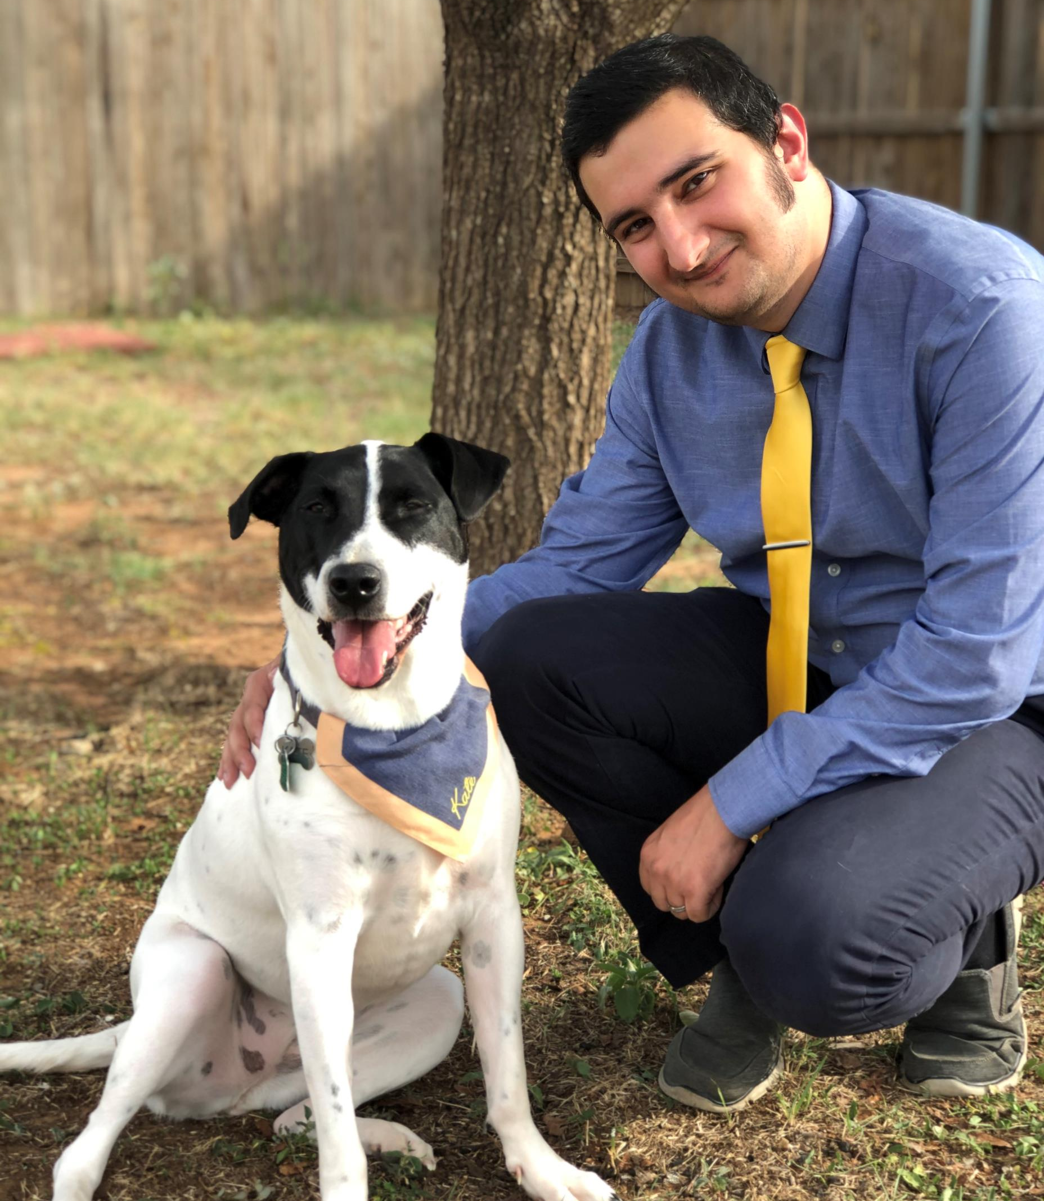
I’m Farhang!
Full name: Farhang Forghanparast
4th year Ph.D. student in Civil Engineering-Water Resources Management
Research: Application of machine learning techniques in sustainable management of water resources
Gaming, movies, writing plays, and photography
Favorite spots in Lubbock: Texas Tech campus, Evie Mae's BBQ

Slide 3

Teach them to pronounce “Farhang”!
An overview
How the labs will work
Tips and Warnings

Slide 4
“Do the work, you'll be fine!”
“Really pay attention to the labs and don't be afraid of going to the extra meetings”
“Don’t skip class like a lot of my classmates did, if you attend the lectures you can ask questions and wont risk confusion later on.”
“Make sure to ask questions if you have any in class!”
“Google is your best friend. Also complete the labs as soon as possible.”
What have you heard about this course?
“Be prepared for statistics and data science.”
Here are some advice from the ones who were here before you!
“Use office hours with Farhang and learn how to be patient with coding.”
“Take advantage of all the examples and read up on the outside resources that are recommended.”
“Be disciplined about attending the labs and finishing them early and the class will be straightforward.”
“Attend class, and make sure you pay attention. Missing one class can set you back!”
“Really pay attention to the labs and don't be afraid of going to the extra meetings”

Slide 5

Here are some advise from us !
“The internet has answers, or something close enough to adapt to your problem! “
“A lot of times you simply have to tinker to get things done”
“get comfortable with error messages, they are not value judgements!”
- Dr. Cleveland
“This is unlikely to be your easiest course. BUT everything you need, will be given to you. Be Active, Ask Questions, and Practice! More important than the “A” that you will get, will be the mindset that you will take from this.”
- Farhang

Slide 6

Days and Times
Lab sessions
Tuesdays and Thursdays – 11:30 am until 12:50 pm
Shortly after Dr. Cleveland’s lectures
Office hours (Online)
Mondays: 9:00 am until 10:00 am
Wednesdays: 5:00 pm until 6:00 pm

Slide 7


How will the labs work?
Two sessions per week
Follows the lectures
Online
Requires Jupyter Notebook
You should submit the completed lab notebooks on BlackBoard
One Homework per week
Series of exercises based on each week’s material
Will be given to you as a template notebook
You should submit the lab assignment notebooks on BlackBoard
You will have 7 days to work on each homework

Slide 8

Make sure to read the syllabus and pay extra attention to …
The deadlines
The exam dates
The project dates
DO NOT miss the deadlines…
50% deduction for late submissions for up to 3 days
After 3 days, the submissions will not be graded or scored
The solutions will be available on the content server 3 days after the due date.
DO NOT leave things for the last minute…
You may realize that you need to ask some questions but it’s too late
There will be connection issues
The servers will be down
Make sure to use ALL your resources…
Lecture and Lab notebooks and videos
The extra resources (books, papers, blogs, videos) given to you in the lab
Your best friend: GOOGLE!
Other search engines as well! – duckduckgo.com

Slide 9
Collaborating can be good!
While in this course, similar to many other engineering practices, working in groups and collaborations are encouraged…
All of you must follow the ethical conduct policy: Office of Student Conduct's website: https://www.depts.ttu.edu/studentconduct/academicinteg.php
If you work together on codes, make sure that you submit your own unique submissions, do not copy and paste someone else's work, and avoid submitting identical documents (e.g., Pdfs. notebooks).
Spend the time, practice hard and be patient…
This is going to be a different learning curve for each one of you- Sometimes smoother and sometimes steeper.
Expect and face the challenge. Do not let it overwhelm you. Do not let it scare you.
You will not be alone.
ASK!
Ask your questions- From me, From Dr. Cleveland, From each other during the lab sessions, during office hours, over email

Slide 10


You can contact me via this email:
Farhang.forghanparast@ttu.edu
Come to the office-hour meetings (Twice a week) and discuss your questions and concerns
We can talk four time a week so you will have plenty of opportunities to ask your questions.

Slide 11

Thank you for your attention…

